Slide 1
TTCS System Proposal for Orenda Marine Engines
by JGRC Consulting

Slide 2

Executive Summary
Facilitates communication via asynchronous, scheduled requests
Provides accountability through reporting
Improves reliability in all areas of business
Graeme

Slide 3
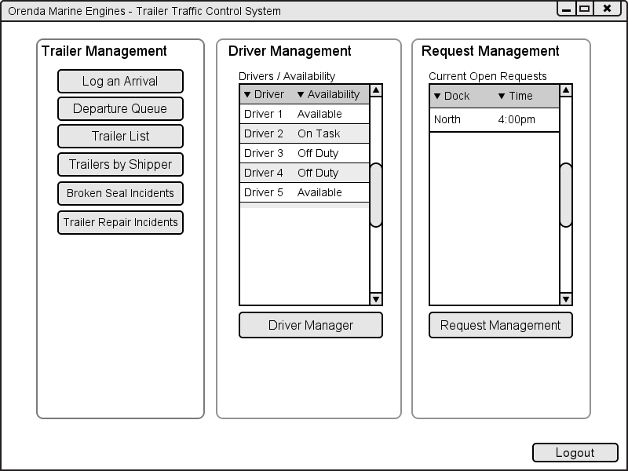
Intro to Dispatcher Dashboard
Corey

Slide 4

Trailer Arrivals

Slide 5
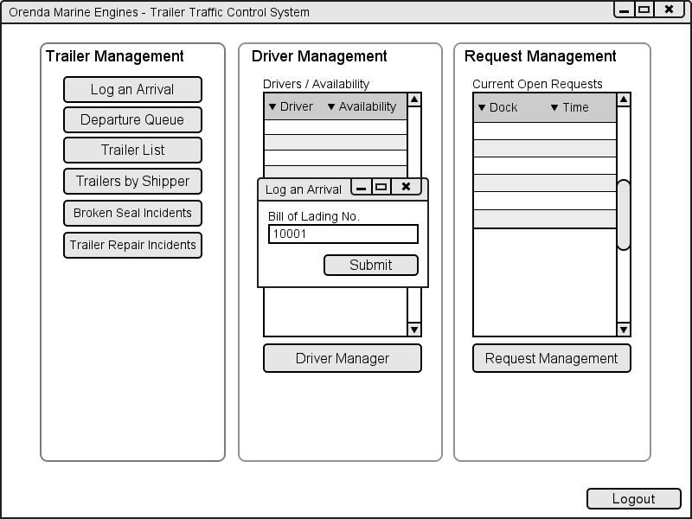
Log Trailer Arrival
Corey

Slide 6
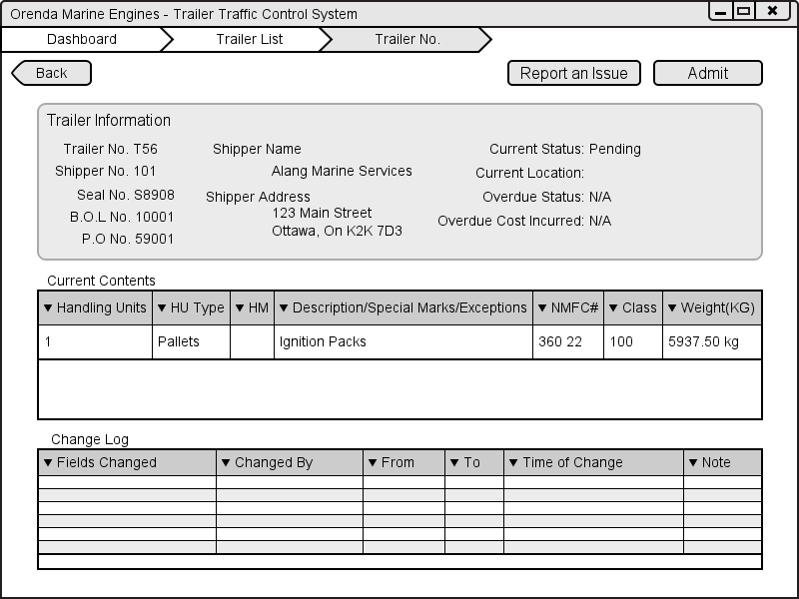
Trailer Admission
Corey

Slide 7
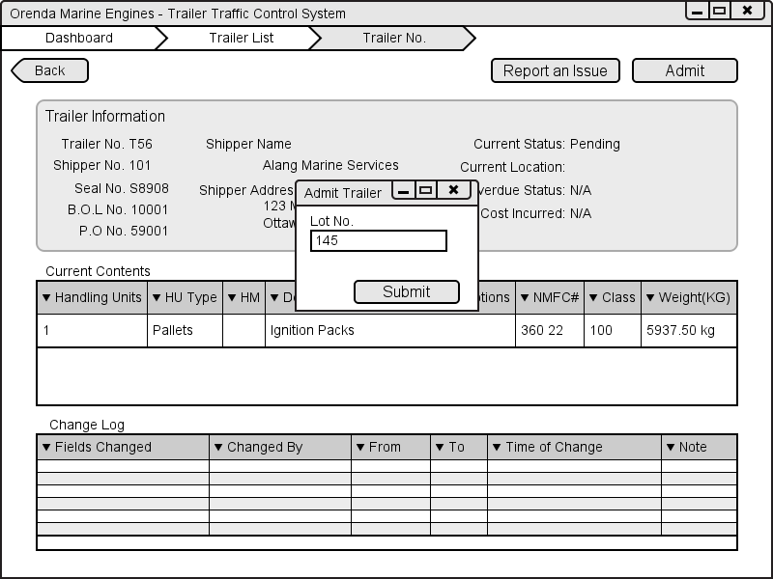
Choosing Parking Spot
Corey

Slide 8
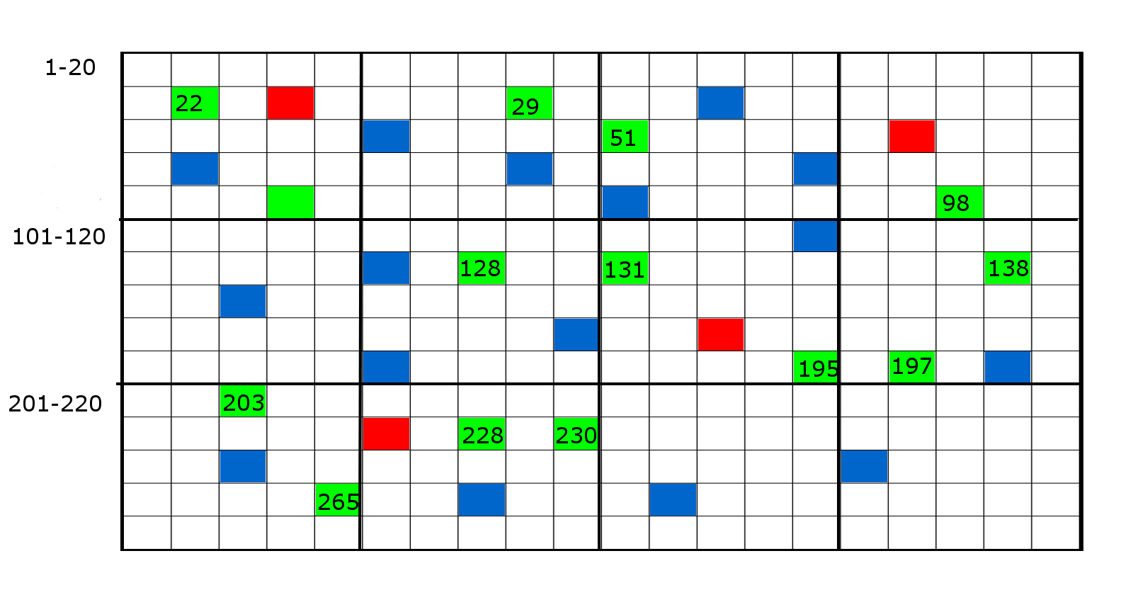
Yard Map
Corey

Slide 9
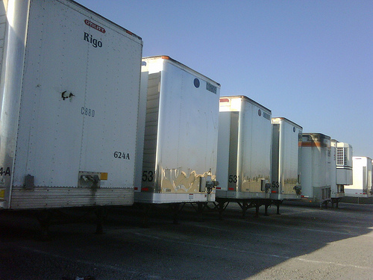
Requests for Trailer Movements

Slide 10
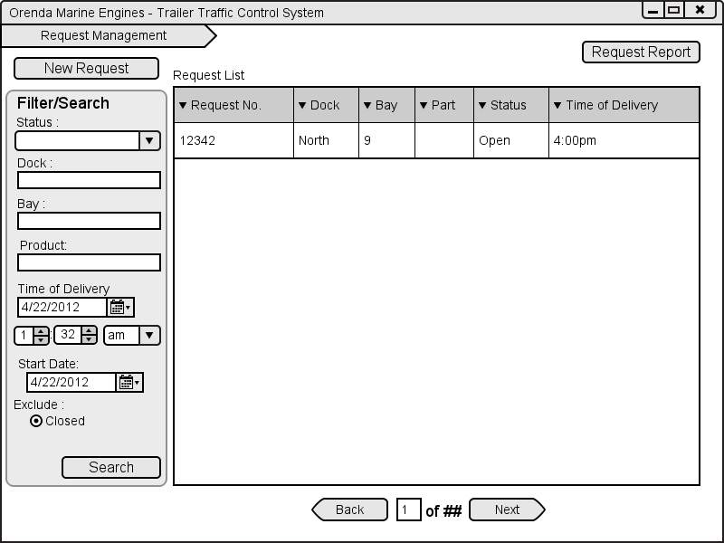
Requests – Dock Foreman
Jack

Slide 11
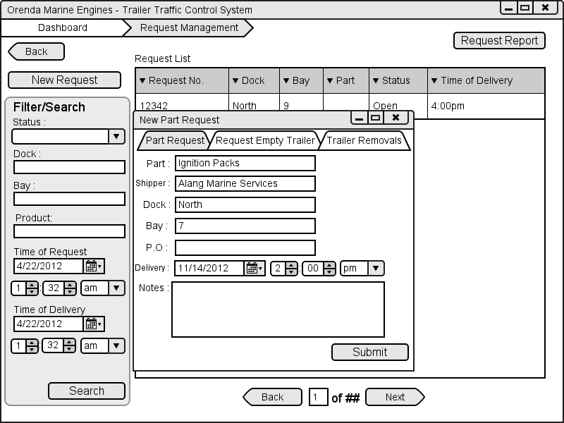
Requests – Dock Foreman Cont.
Jack

Slide 12
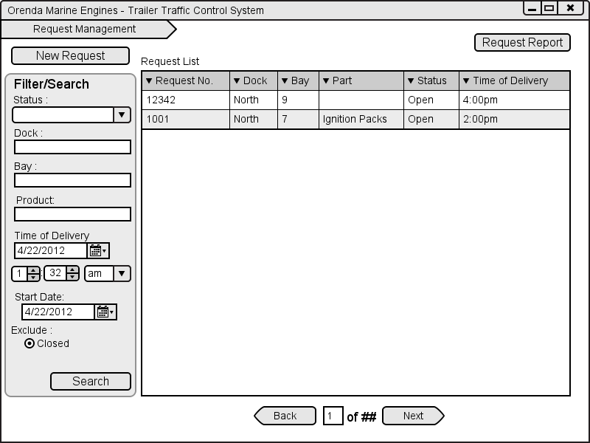
Requests – Dock Foreman Cont.
Jack

Slide 13
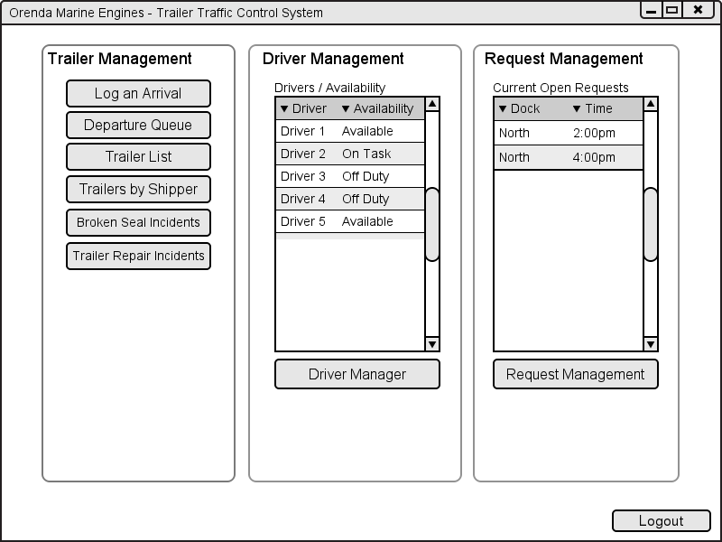
Requests – Dispatcher
Corey

Slide 14
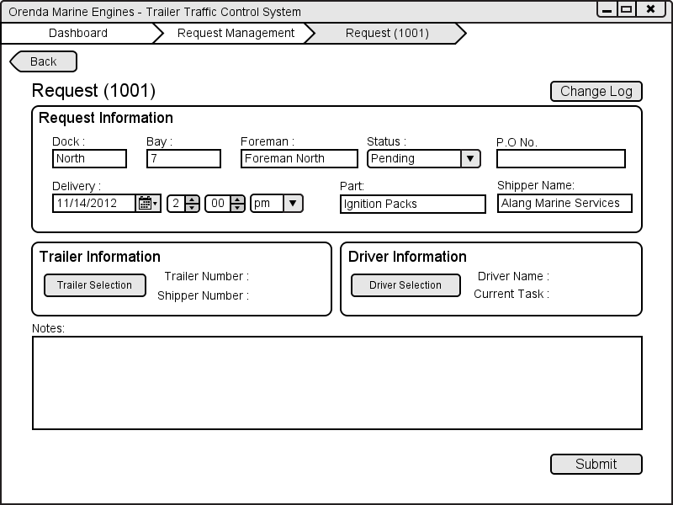
Requests – Dispatcher cont.
Corey

Slide 15
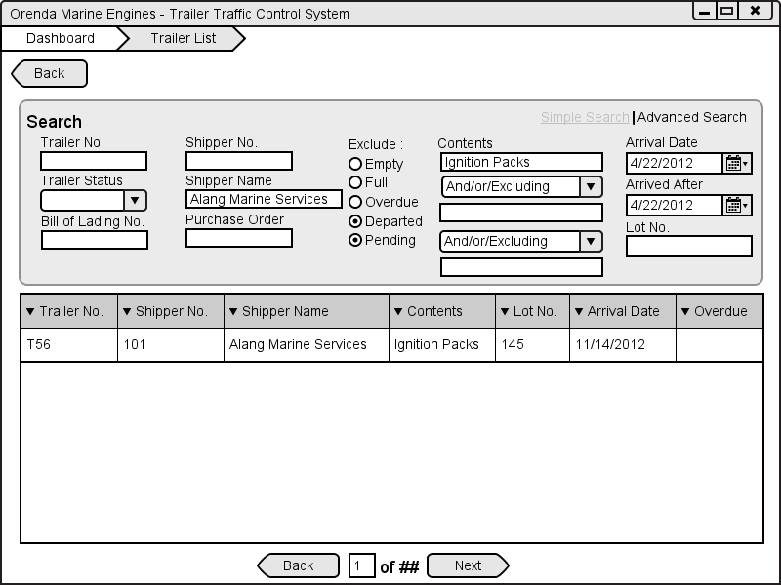
Requests – Dispatcher cont.
Corey

Slide 16

Requests – Dispatcher cont.
Corey

Slide 17
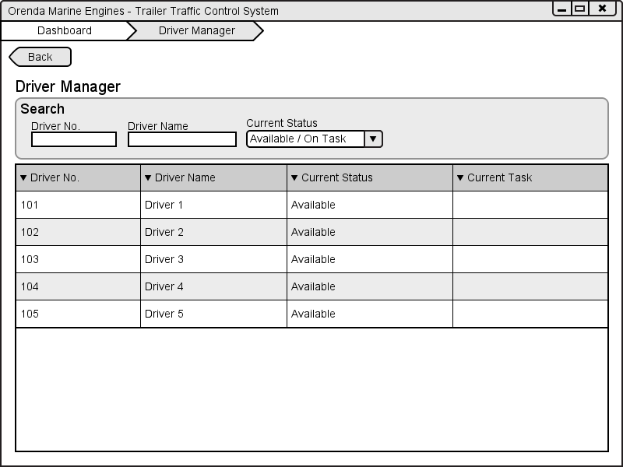
Requests – Dispatcher cont.
Corey

Slide 18
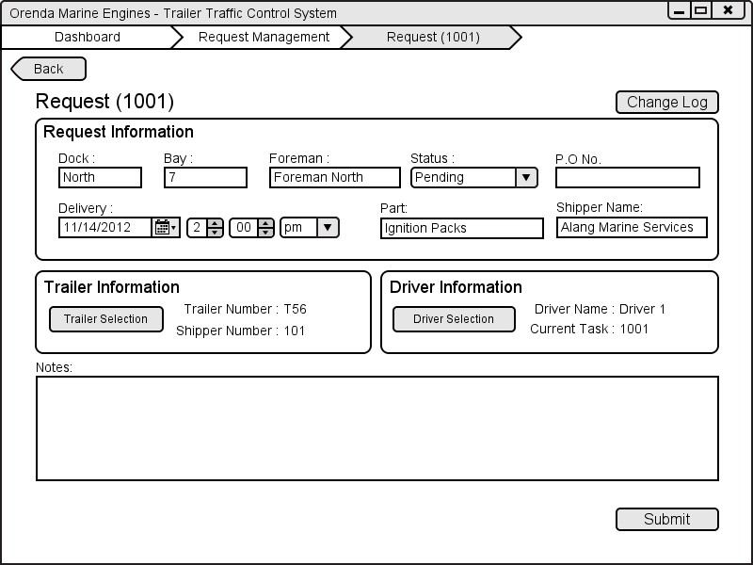
Requests – Dispatcher cont.
Corey

Slide 19

Driver Task Tracking System

Slide 20
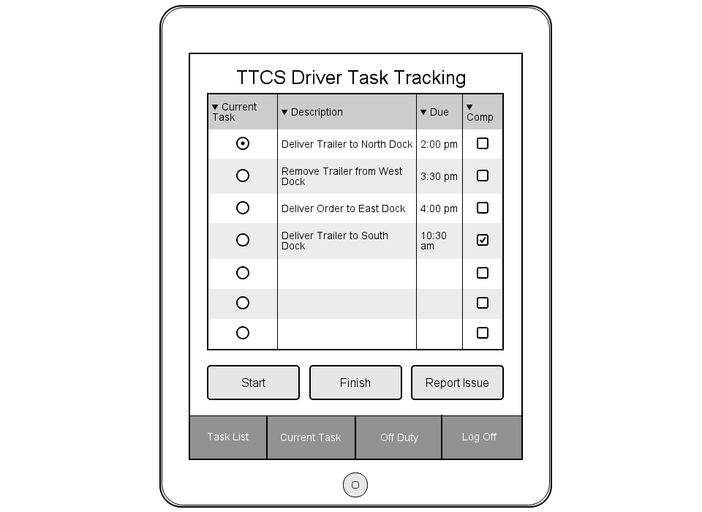
Task List
Ryan

Slide 21
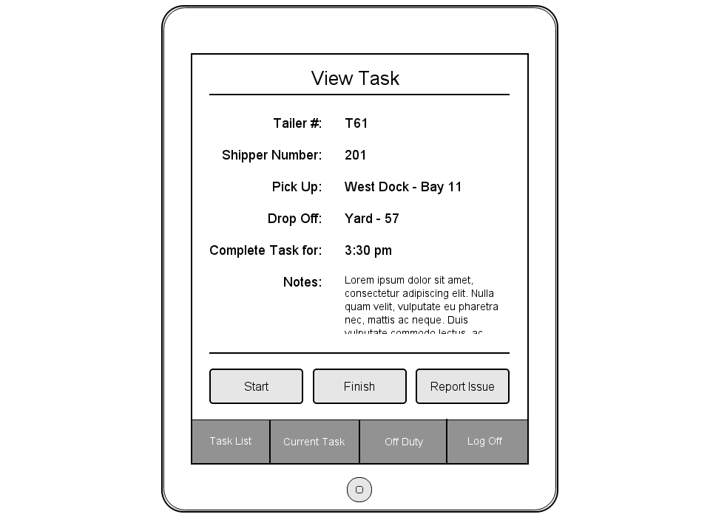
View Task
Ryan

Slide 22
Task List
Ryan

Slide 23
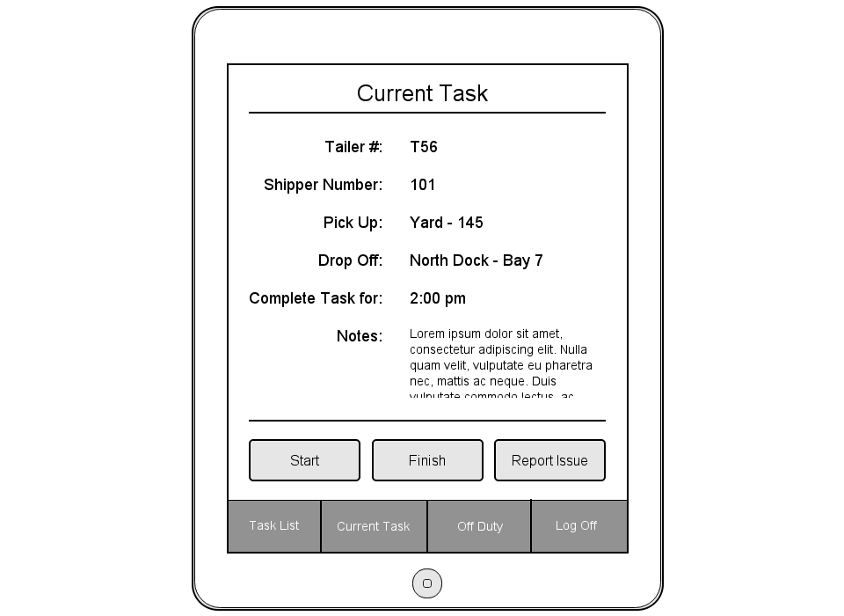
Current Task
Ryan

Slide 24
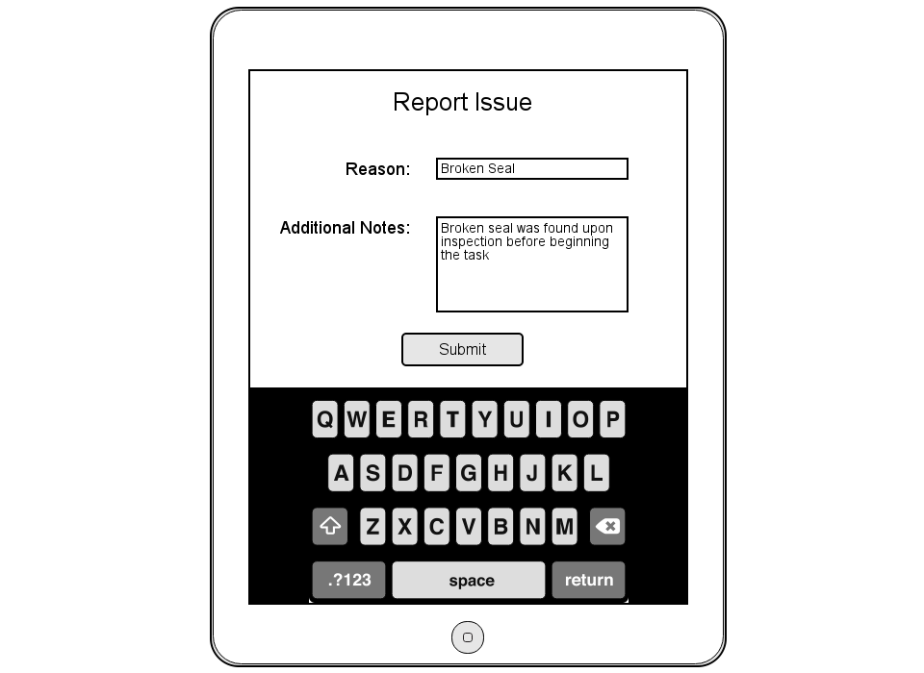
Report Issue
Ryan

Slide 25
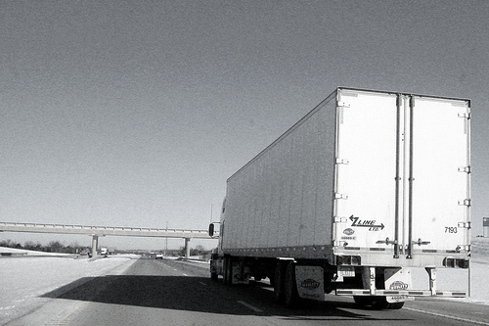
Trailer Departures

Slide 26
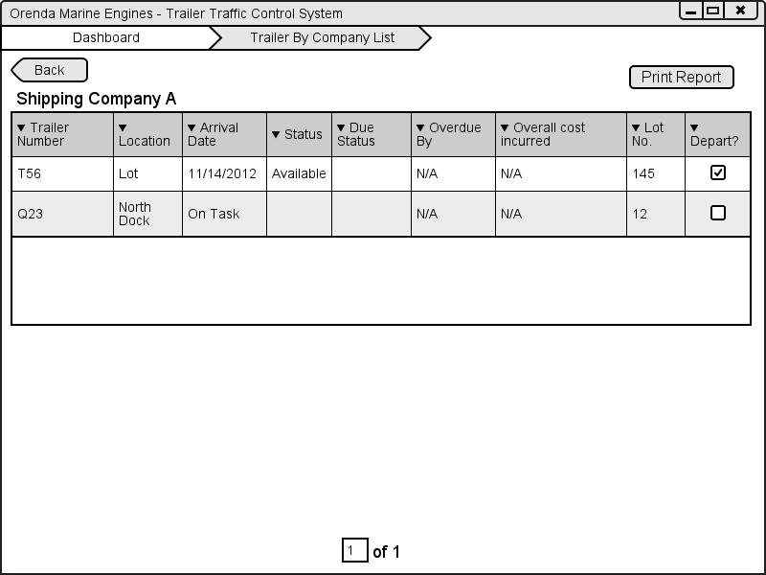
Marking for Departure
Graeme

Slide 27
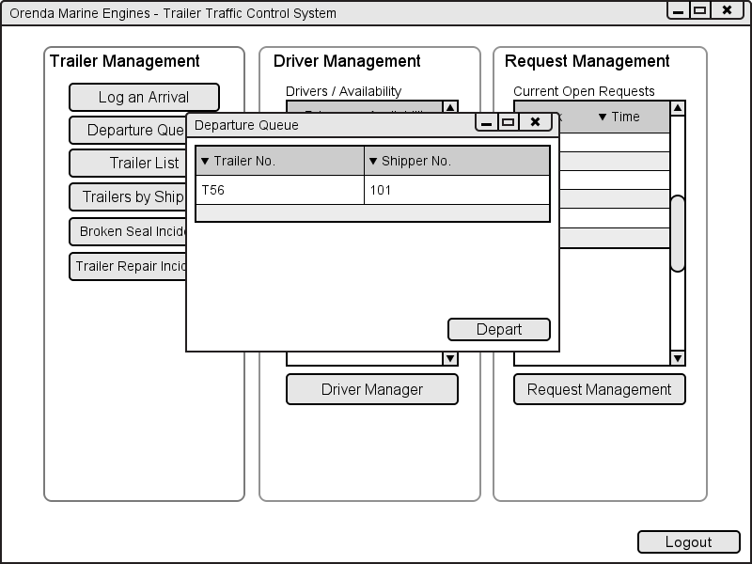
Departure Queue
Graeme

Slide 28
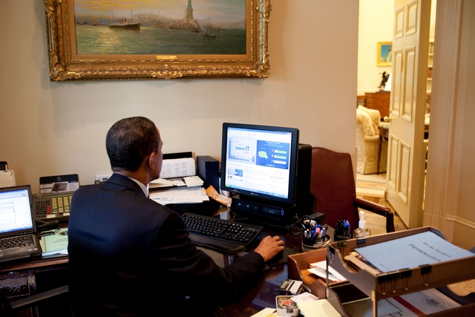
Executive Dashboards

Slide 29
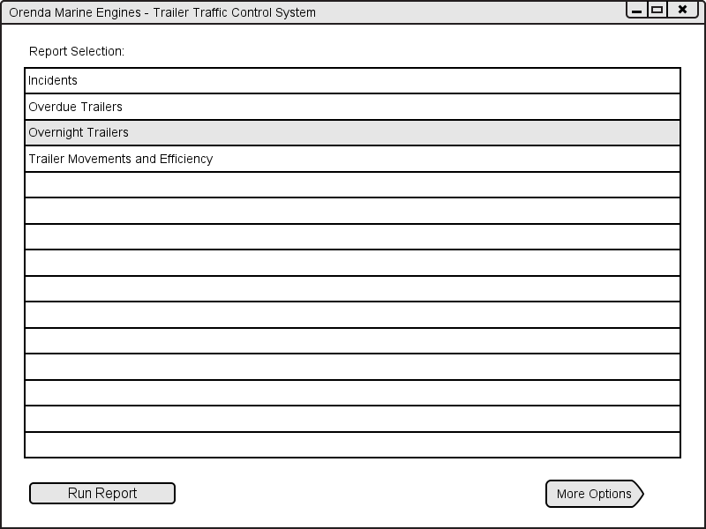
Simple View
Graeme

Slide 30
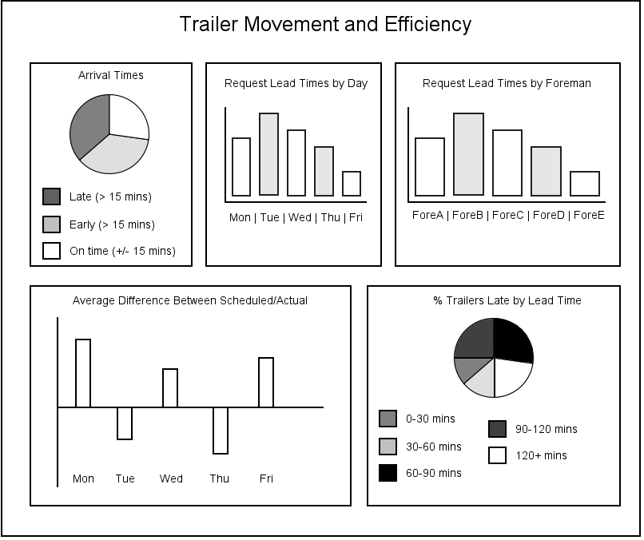

Slide 31
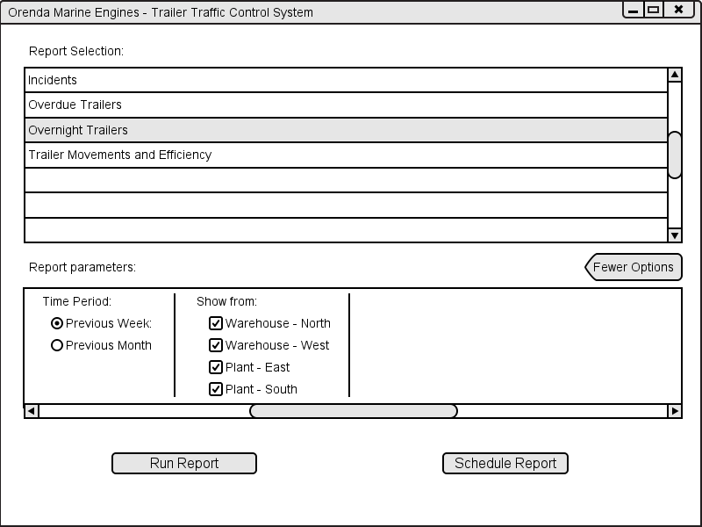
Expanded View
Graeme

Slide 32
Conclusion
Issue Resolution Through Accountability
Asynchronous Requests
Reliability
Ryan

Slide 33
Questions?

